Slide 1
What is Robotics?
By Lau van Wingerden and Lucre Simon
Notes:
Teaching robotics needen’t be scary or require a big budget. As with many other subjects, the internet offers many resources. Teaching robotics ranges from introducing children to simple concepts of design and engineering to elaborated coding tasks to playing with toybots.
When we started planning this presentation L and realized that most children today are able to figure out how to operate a robot and we also thought not all schools have budgets that allow them to purchase toyrobots like these you see here. So we decided to show you how robotics can be introduced in the school with simple materials and a small budget.
But first, what is robotics?

Slide 2
Robotics:
An interdisciplinary branch of engineering and science that includes:
mechanical engineering;
electrical engineering;
computer science;
artificial intelligence;
mechatronics, and
nanotechnology.

Slide 3
Robotics:
Deals with the design, construction, operation, and use of robots, as well as computer systems for their control, sensory feedback, and information processing.

Slide 4
Why teach Robotics?
Increases creativity and problem solving skills.
Prepares students for future employment (STEM).
Develops team building skills.
Suitable for children with a range of abilities
Notes:
Prepares students for future employment:
Jobs in the STEM (science, technology and mathematics) field are the fastest growing careers and are projected to continue to grow. These industries will need people with new and innovative ideas, who have the knowledge to design and create the technology needed.
Introducing students to robotics in their school years gives them the opportunity to discover possible interests and talents in this job market. Without the knowledge or access to robotics education, there’s no way for students to build interest in these fields. Without robotics education in public schools, who knows how many potential creators and innovators there are who were never given the resources to realize their potential.

Slide 5
Robotic Hand Activity:
https://www.youtube.com/watch?v=YTN-gHZNMX8&feature=youtu.be
Purpose of the activity:
To build a functional robotic-like hand that is able to grasp a light object (e.g. crumbled piece of paper).

Slide 6
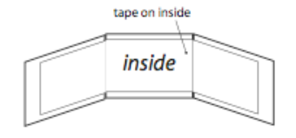
Robotic Hand Activity:
To make a finger: take 3 of the 2 cm x 3 cm pieces of cardboard.
Place the 3 equal finger pieces together and use tape to connect all of them, placing the tape on the inside. (See below.)
Tape on the inside
Notes:
Grade: 3-5
This activity leads students to build and test a robotic-like hand.
Three fingers with options of palms to choose from. All have holes in the centre. But they can decide how to assemble it.
One finger is pre-assembled; students build two fingers.
If students finish with enough time, test picking up a ball of crumbled paper

Slide 7
Robotic Hand Activity:
Remember: the tape is on the inside of the finger.
Turn the finger over so that the “inside” is facing down.
Take a 2.5 cm piece of rubber band and attach it across the first joint (see diagram below).
Tape 2.5 cm Rubber Band

Slide 8
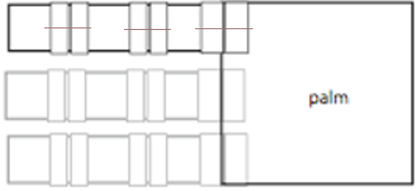
Robotic Hand Activity:
Repeat step 5 for the second joint.
Tape the finger onto the palm , with the “inside” facing up.
Turn the hand over.
Cut a rubber band 2.5 cm long.
Put the rubber band across the last joint (touching the palm). (See diagram below.)
2.5 cm Rubber Band
Outside of Palm

Slide 9
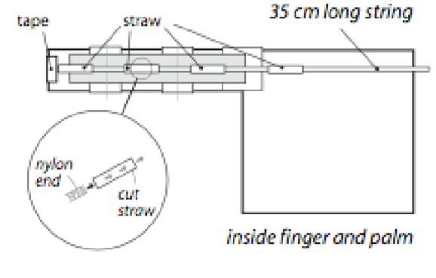
Robotic Hand Activity:
Cut a piece of cord 35 cm long.
Tape one end of the cord over the end of the finger (see diagram below).
Cut 4 pieces of straw 2 cm each.
Tape Straw
35 cm long string
Nylon End
Cut
Straw
Inside Finger and Palm

Slide 10
Robotic Hand Activity:
Thread the pieces of straw onto the nylon cord.
Tape a piece of straw in the middle of each finger section.
Tape the last straw to the palm (see diagram below).
Repeat step 1-16 for as many fingers as you would like.
Tape Straw
35 cm long string
Nylon End
Cut
Straw
Inside Finger and Palm

Slide 11
In the Classroom:
This lesson might be better done as unit to incorporate multiple robotic ideas such as:
Design,
Creation,
Resource management,
Material selection,
Testing,
Retesting.
Notes:
Comment: worth mentioning that we redesigned this too. We changed materials.

Slide 12
Resources:
Nasa Website: www.nasa.gov/audience/foreducators/robotics/lessonplans/index.html#.Wl2IS6jibIU
Hour of Code: www.code.org/learn
Scratch: www.scratch.mit.edu/tips
Notes:
Conclusion:
Consider this activity more as a unit based on design, creation and testing. You are not time-constrained.
Nasa has lessons as simple as the one we will be working on today to more complex alternatives in which students build robots using calculators to hands-on engineering challenges. There are lessons for all grades from kindergarten to grade 12.

